Slide 1

Team Decision “Team decision-making strategies should therefore be used when you want to get participation and achieve consensus”
Sanjeeva Perera - Senior Academic Fellow
Department of Computer Systems Engineering,
Faculty of Computing

Slide 2
Attendance

Slide 3
Decision making

Slide 4
ICC Cricket World Cup 2019 Final Overthrow Controversy: Umpire Kumar Dharmasena Admits Mistake
During the New Zealand vs England ICC Cricket World Cup 2019 final umpire Kumar Dharmasena awarded England six runs from an overthrow after the ball ricocheted from Ben Stokes bat towards the boundary. As per the rules, only five runs should have been awarded and the one extra run could have changed the result of the match. The final match was eventually tied and also the Super Over ended in a tie. England were then named winners on superior boundary count. Meanwhile, Dharmasena has admitted his mistake.

Slide 5
ICC Cricket World Cup 2019 Final Overthrow Controversy: Umpire Kumar Dharmasena Admits Mistake

Slide 6
Aim of the Lecture
What is the aim?
Aim of the lecture is
to provide teams with
theoretical frameworks,
strategies and
tools
that they can be used when they are making decisions.

Slide 7

Decision
Decision –
"the act of making up your mind about something, or a position or opinion or judgment reached after consideration"

Slide 8
Decision Making
The cognitive process of reaching a decision.
A position or opinion or judgment reached after consideration
Choosing between alternative courses of action using cognitive processes - memory, thinking, evaluation, etc.
The Process of mapping the likely consequences of decisions, working out the importance of individual factors, and choosing the best course of action to take
In a Team ;
Process through which team selecting alternatives which are important for Team Performance

Slide 9
Decision Making
Why we need to learn this?
To make informed choices in team decision making processes
To get everyone involved in the decision-making process
To justify your decisions to different audiences

Slide 10
Decision Making is a Logical and Systematic Process
Create a constructive environment - (Goal/Right People/Opinions)
Generate good alternatives - (Ideas/Different Perspectives/Organize Ideas)
Explore these alternatives - (Risks/Impacts/Validations)
Choose the best alternative - (Grid Analysis/Decision Trees)
Check your decision.
Test assumptions & Decisions with own Experience
Check for Common Decision Making Problems
Check the Logical Structure of the Decision
Communicate your decision, and take action

Slide 11
Decision Making is a Logical and Systematic Process (Buying a Car)
Create a constructive environment - (Goal/Right People/Opinions)
The goal is to purchase a car that meets your daily needs, fits within your budget, and provides good value over time. This includes considering factors such as reliability, fuel efficiency, and comfort.
Involve key people who will influence or be affected by the decision, such as your spouse, family members, or a trusted friend who is knowledgeable about cars. If you have a mechanic or car expert you trust, their input can be valuable.
Open the floor for opinions from everyone involved. For example, if you have a family, consider their views on the car's size, safety features, and comfort. Discuss what everyone is looking for in the new car, such as safety, technology features, or fuel efficiency.

Slide 12
Decision Making is a Logical and Systematic Process (Buying a Car)
Generate good alternatives - (Ideas/Different Perspectives/Organize Ideas)
Brainstorm a list of car models that meet your criteria. Consider different types of vehicles (sedan, SUV, hybrid, electric), and create a list of makes and models that are known for reliability and value.
Gather insights from different sources. For instance, look at car reviews from trusted automotive websites, ask for recommendations from friends or colleagues, and check consumer reports for reliability ratings.

Slide 13
Decision Making is a Logical and Systematic Process (Buying a Car)
Explore these alternatives - (Risks/Impacts/Validations)
Evaluate the risks associated with each option. For example, buying a used car might involve unexpected maintenance costs, while a new car might depreciate quickly. Consider the warranty coverage and the availability of spare parts.
Think about the long-term impacts, like fuel costs, insurance premiums, and resale value. For example, a hybrid car might save on fuel costs but could have higher initial costs.
Validate your alternatives by test-driving the cars, checking online customer reviews, and talking to current owners.

Slide 14
Decision Making is a Logical and Systematic Process (Buying a Car)
Choose the best alternative - (Grid Analysis/Decision Trees)
Create a comparison grid where you score each car based on criteria like cost, fuel efficiency, safety, comfort, and brand reputation. Assign weights to each criterion based on its importance to you.
Develop a decision tree to explore different scenarios, such as the costs of choosing a used car versus a new one, or the potential savings of a hybrid car over time compared to a conventional car.

Slide 15
Decision Making is a Logical and Systematic Process (Buying a Car)
Check your decision.
reflect on past car purchases or experiences. Did you encounter issues with certain brands or models? What features or aspects of previous cars did you appreciate or regret? Use these experiences to guide your current decision.
Be aware of biases like favoring a car due to brand loyalty or being swayed by a salesperson's pitch. Ensure that your decision is based on objective criteria and not just emotional appeal.

Slide 16
Decision Making is a Logical and Systematic Process (Buying a Car)
Test assumptions & Decisions with own Experience
Clearly communicate the decision to anyone involved, explaining why this particular car was chosen based on the analysis and criteria. If others were involved, ensure they understand the rationale behind the choice.
Take action by negotiating the best price with the dealer, securing financing if needed, and completing the purchase

Slide 17
Decision making
Three main areas that support systematic process are:
1. Environments for decision making
2. Methods for decision making
3. Tools for decision making

Slide 18

Environments for Decision Making

Slide 19
Features of a Thinking Environment
Attention
- listening with respect, interest and fascination to your team members
Incisive (sharp) Questions
- removing assumptions that limit ideas
Equality
- treating each team member as a thinking peer
Appreciation
- practicing a 5:1 ration of appreciation to criticism of your teammates and their ideas
Ease
- ease creates. Urgency destroys

Slide 20
Features of a Thinking Environment
Encouragement
- moving beyond competition with your teammates to collaboration
Feelings
- allowing sufficient emotional release to restore thinking
Information
- providing a fuller, more accurate picture of reality
Place
- creating a physical environment that says ‘You matter
Diversity
- adding quality because of the differences between participants

Slide 21
Methods for Decision Making
Understanding the decision-making methods will help you to make the best decision available.
Best Decision
would not have been thought of by an individual alone
a sound solution to the problem
a decision based upon input, as unbiased as possible, from each team member
addresses the team’s goal for the decision-making process.
Methods describe how we work, how they affect and manipulate the team decision making process in productive ways.

Slide 22
Methods of Decision Making
1. Decision by consensus
Time available allows a consensus to be reached; the team is sufficiently skilled to reach a consensus; the team commitment required to implement the decision is high.
2. Decision by majority vote
Time constraints require decision; group consensus supporting voting process; team commitment required to implement decision is moderately high.
3. Decision by minority vote (EXCO)
Limited time prevents convening entire team; clear choice of minority group; team commitment required to implement the decision is moderately low

Slide 23
Methods of Decision Making
4. Decision made by authority after group discussion
Available time allows team interaction but not agreement; clear consensus on authority; team commitment required to implement decision is moderately low.
5. Decision by averaging individuals’ opinions
Time available for decision is limited; team participation is required, but lengthy interaction is undesirable; team commitment required to implement the decision is low.
6. Decision by expert
Highly dependent on specific expertise, clear choice for expert
7. Decision made by authority without group discussion
Simple, routine, administrative decisions; little time available to make decision;

Slide 24

Tools for Decision Making
Why we need tools?
In addition to creating an environment for effective decision making and using methods for making decisions as a team, tools can assist teams in formulating and reaching decisions.

Slide 25

Tools to assist teams for Decision Making
Brainstorming
Brainstorming is a group creativity technique by which efforts are made to find a conclusion for a specific problem by gathering a list of ideas spontaneously contributed by its members
Wikipedia

Slide 26
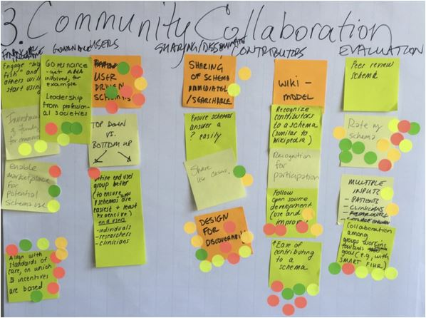

Tools to assist teams for Decision Making
Affinity Grouping
Grouping unstructured ideas (Generated from Brainstorming) based on their natural relationship

Slide 27
Tools to assist teams for Decision Making
Multi-voting (good to evaluate best option during Brainstorming)
The multi-voting technique holds an answer to your problems when decision making becomes tough, because of too many options/alternatives.
Process: Each member is given many votes (Ex: 1/3 or 1/2 of the options), Run it many rounds.
Example : Members of a Command's Planning Board for Training conducted
meetings which were not always as productive as they might have been. The XO
called a meeting to identify the reasons for the lack of meeting productivity and to
determine which reasons the team thought most important. The XO led a
Brainstorming session which produced the following list:

Slide 28
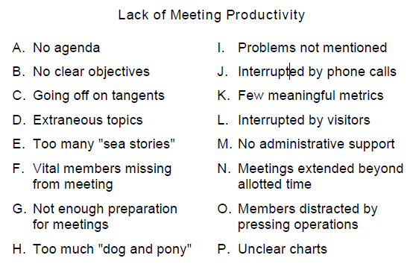
Tools to assist teams for Decision Making
The team used Multi-voting to reduce this list to a manageable size:
Each of the 6 members of the team was allowed 8 votes (half the number of items)

Slide 29
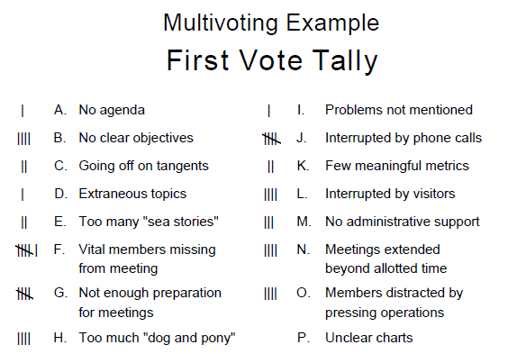
Tools to assist teams for Decision Making
The votes were tallied, as shown in and the top 8 items were carried forward to the second round.

Slide 30
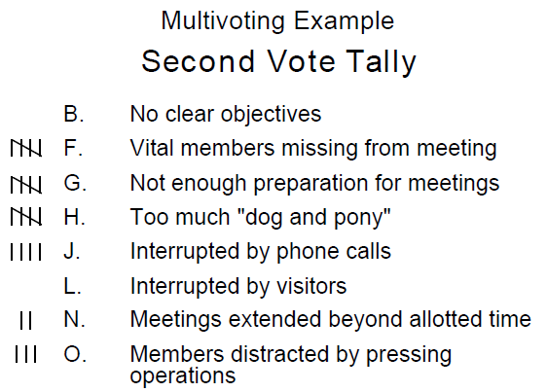
Tools to assist teams for Decision Making
The items that had 4 or more votes in the first round were reduced to 4 in a second round of voting. The group chose to focus on problems F, G, H, and J, as shown here

Slide 31
Tools to assist teams for Decision Making
This will repeat to Third vote tally.
Finally top two options for voting. Each person get one vote

Slide 32




What Happens If No Candidate in the Sri Lankan Presidential Elections Secures Over 50% of the Votes?
1. All candidates except the top two will be eliminated from the race.
Now, the 2nd and 3rd preference votes on the ballots of eliminated candidates come into play.
2. Ballots without either finalist marked as a preference are set aside.
3. For remaining ballots: If the 2nd preference is for a finalist, that vote is added to their tally.
4. If the 2nd preference is for an eliminated candidate but 3rd is for a finalist, that vote goes to the finalist.
5. After this process, the candidate with the highest vote count wins.

Slide 33
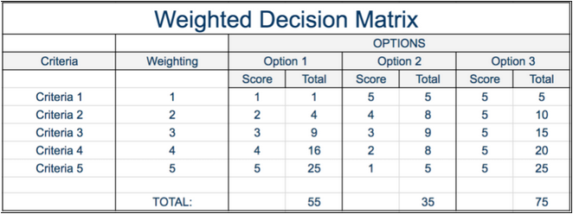
Tools to assist teams for Decision Making
Criteria Matrix
A decision matrix is a list of values in rows and columns that allows an analyst to systematically identify, analyze, and rate the performance of relationships between sets of values and information. Elements of a decision matrix show decisions based on certain decision criteria. Wikipedia

Slide 34
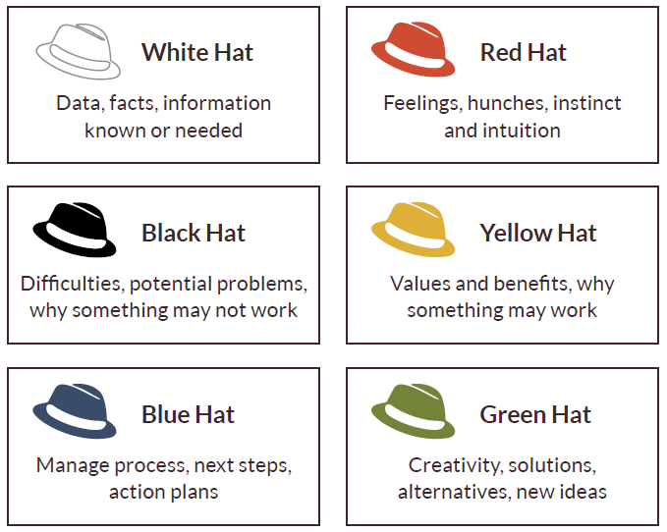
Tools to assist teams for Decision Making
Six Thinking Hats:
Looking at a decision from a range of different perspectives

Slide 35
Important issues of Decisions
Every Decision must address two issues:
1. Merit Dimension – Merits of the decision in some quantitative way
2. Acceptance Dimension – People affected by the decision will accept it

Slide 36
DM in Project Teams (continue...)
Advantages of Team Decision Making
Greater Knowledge: because of the number of people involved, each with differing experience, knowledge, points of view and values, a larger number and variety of ideas for solving a problem can be produced.
Shared responsibility: makes individuals more willing to take risks. The discussion of different points of view also helps the group to be more realistic in assessing the risks associated with particular courses of action.
Higher commitment: individuals who have contributed to finding a solution feel a greater commitment to its successful implementation.

Slide 37
DM in Project Teams (continue...)
Weak Points of Team Decision Making
Time consumption: group problem solving is a relatively slow process compared with working alone.
Less recognition: identifying who really did his/her best is difficult to recognize as it is a collaborative effort thus, less chance for recognition for promotion
Conformity: there is a strong tendency for individuals in a group to want to conform to the consensus. This can be due to a variety of reasons, including the need to feel valued or respected.

Slide 38
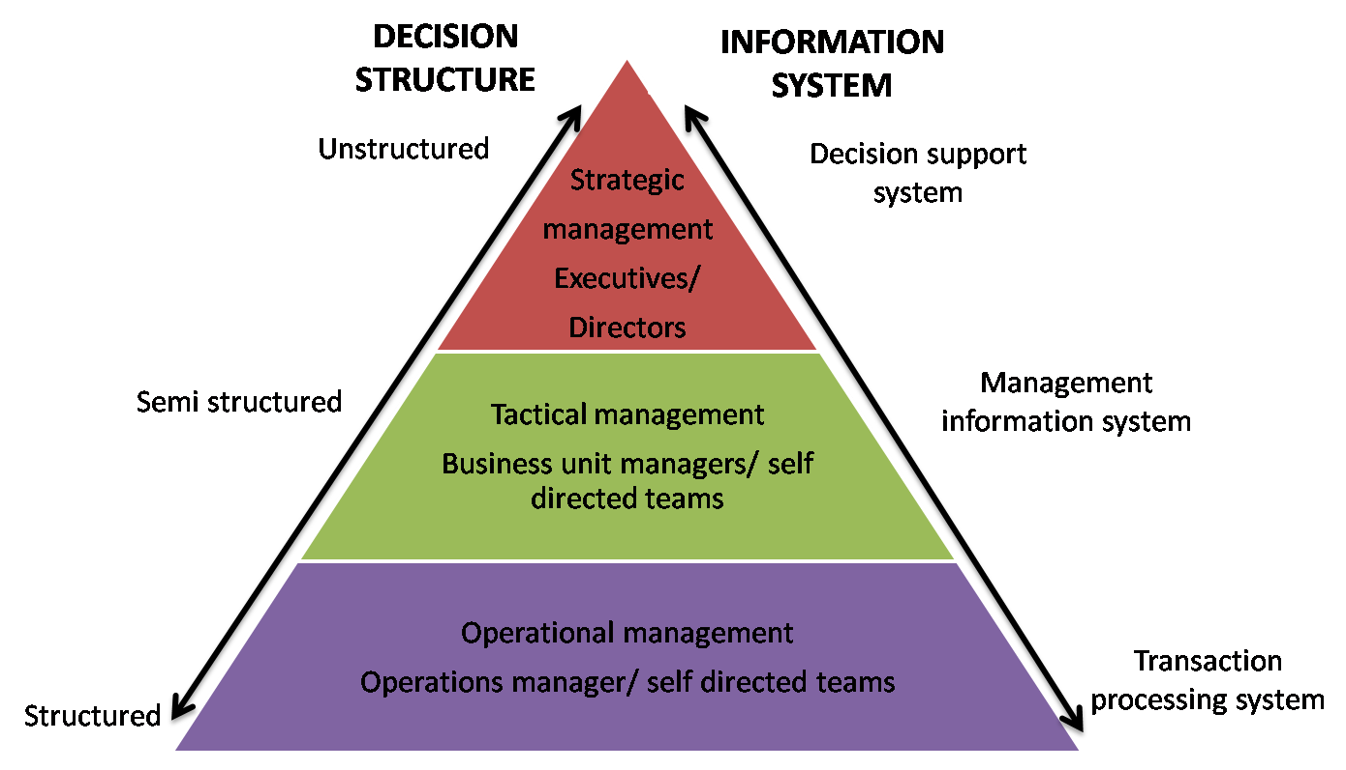
Decision Making and Information Systems

Slide 39
Questions ?

